Slide 1


Closed Settings as Reservoirs
and Drivers for Community
Transmission of Tuberculosis
Robin Wood, Desmond Tutu HIV Centre,
University of Cape Town,
South Africa
TB 2018 Amsterdam
July 22nd 2018

Slide 2
Topics for Discussion
Recent insights on TB transmission biology
Ways to identify transmission hotspots
Potential for intervention and concrete applications
Is community infection control feasible?

Slide 3

Image of trajectories of cough particles
Violent expiratory events: on coughing and sneezing.
Bourouiba L et al. J Fluid Mech. (2014), vol. 745, pp. 537–563.

Slide 4
Mechanisms of Respiratory Particle Production
Wei, Jianjian et al. Airborne spread of infectious agents in the indoor environment. American Journal of Infection Control 2016: 44 (9); S102 - S108

Slide 5
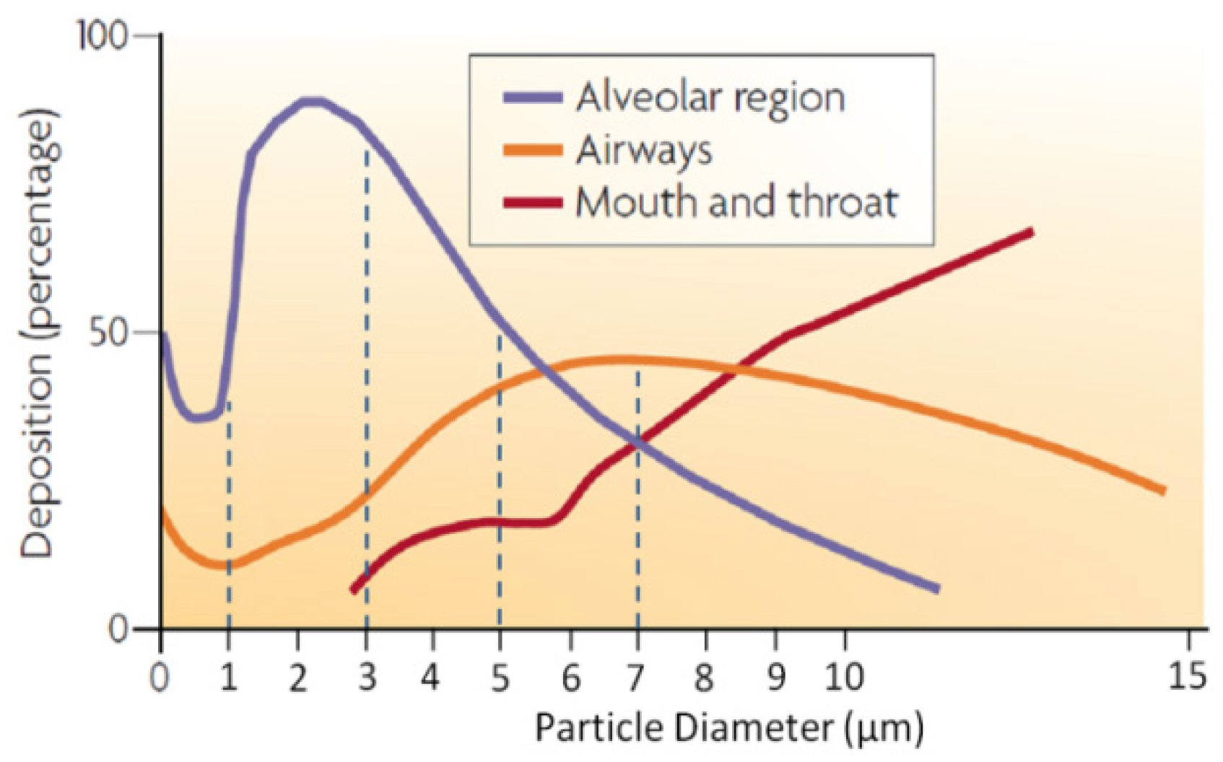
Particle Size and Lung Deposition
Patton, J.S.; Byron, P.R. Inhaling medicines: Delivering drugs to the body through the lungs. Nat. Rev. Drug Discov. 2007, 6, 67–74

Slide 6
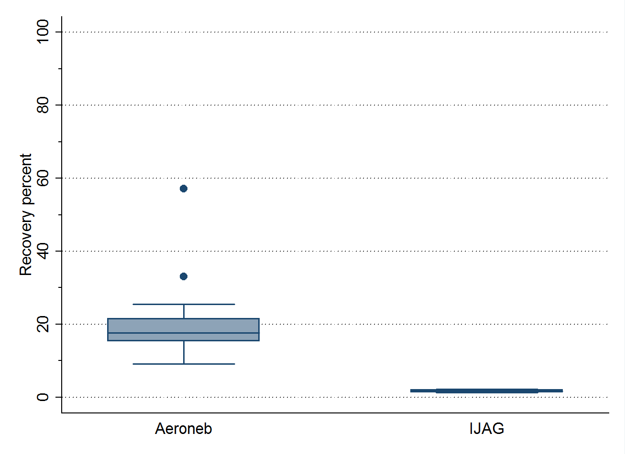
MTB in Bio-Aerosols from TB Patients
Study | Time | Detection | % positive
Riley 1950 | 2-3 months | Guinea pig infection | 13%
Fennelly 2012 | 10 minutes | MTB Culture | 27,7%
Patterson 2017 | 60 minutes | MTB Culture | 43%
High volume 2018 | 60 minutes | DMN-tre microscopy | 100%
1-5 μm
(17.6%)
10 μm
(1.74%)
MTB detection determined by:
1. Bio-aerosol volume sampled
2. Small particle survival
3. Detection sensitivity
Survival of Bacillus globigii
containing droplets

Slide 7
Scanning Electron Microscopy: 1-2.5 micron foil
Patterson et al. Gates Open Research 2017, 1:11

Slide 8
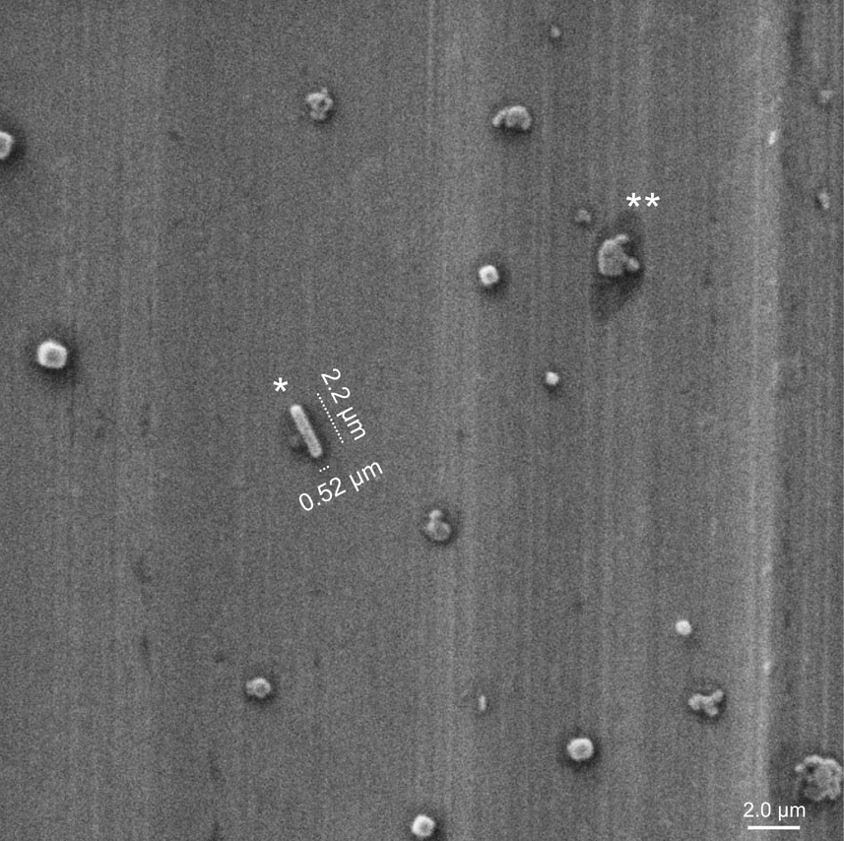
Scanning Electron Microscopy; 1-2.5 micron Foil

Slide 9
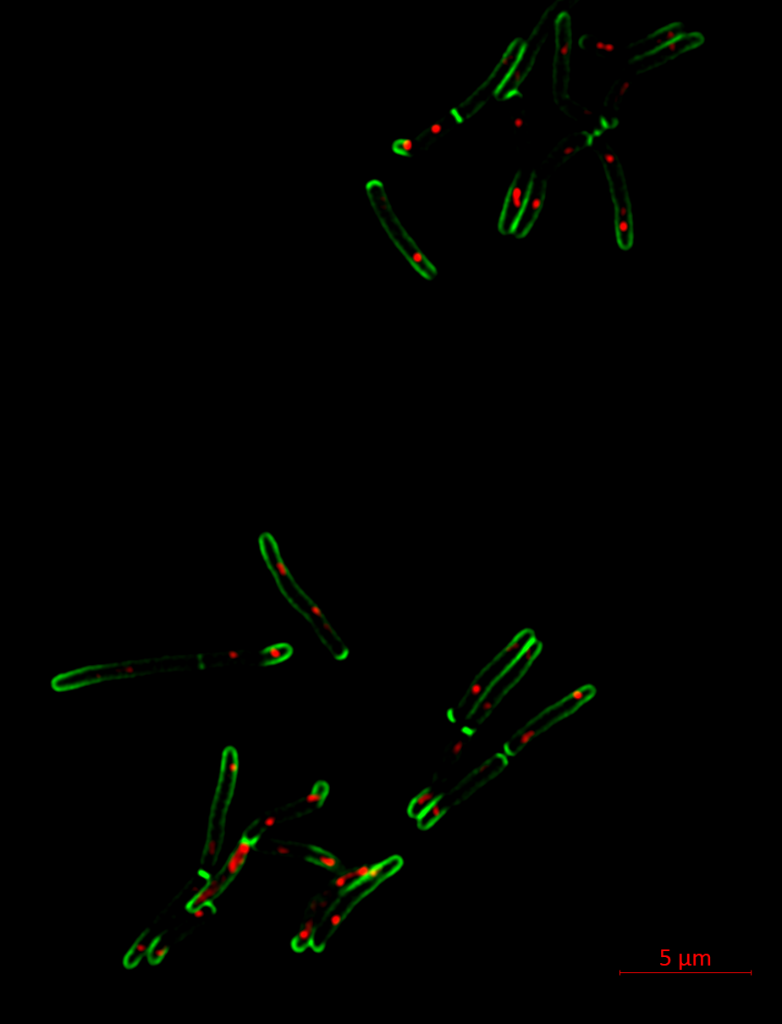
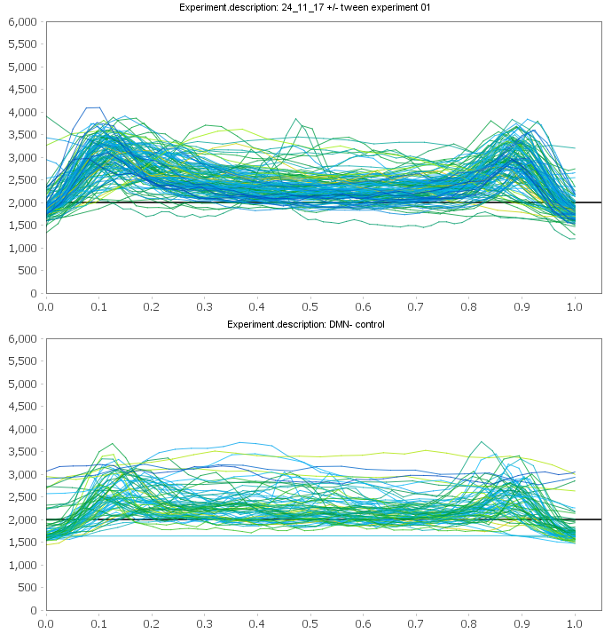
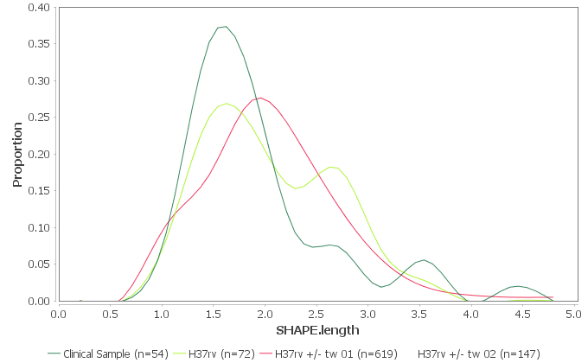
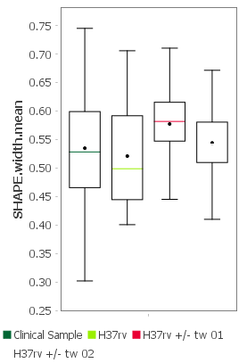
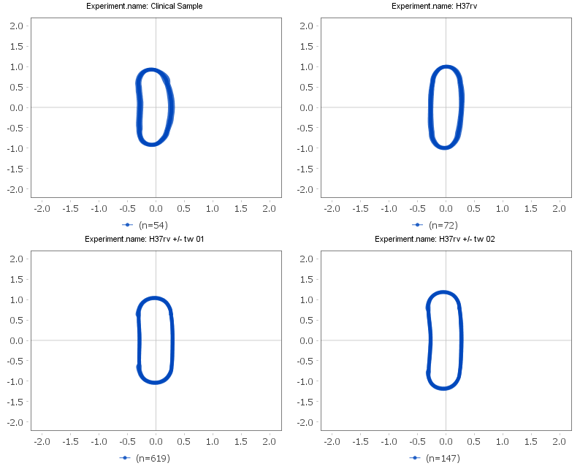
Replicative Status of Individual Mycobacteria
H37Rv Log
Fluorescence Intensity
H37Rv Starved
Frequency
Width (μm)
Length (μm)
Clinical Strains
H37rv Starved
H37rv Log phase
High resolution microscopy of DMN-tre & ParB-mCherry signal used to identify chromosomal number and position (M.smeg).
Sophia Gessner & Ryan Dinkele

Slide 10
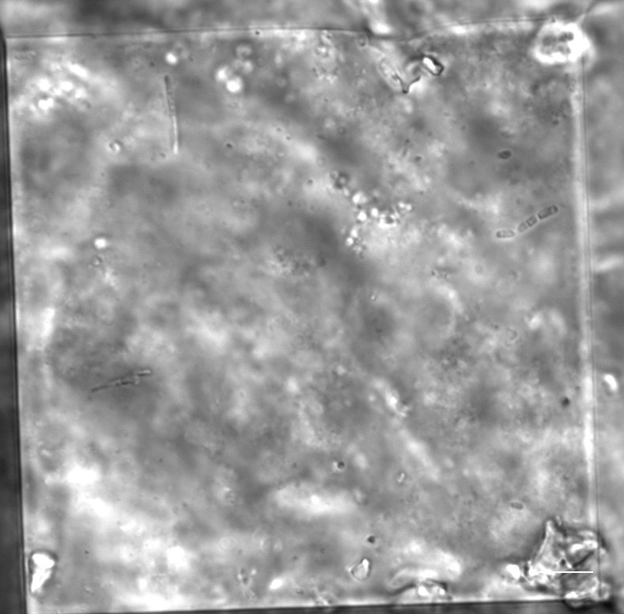
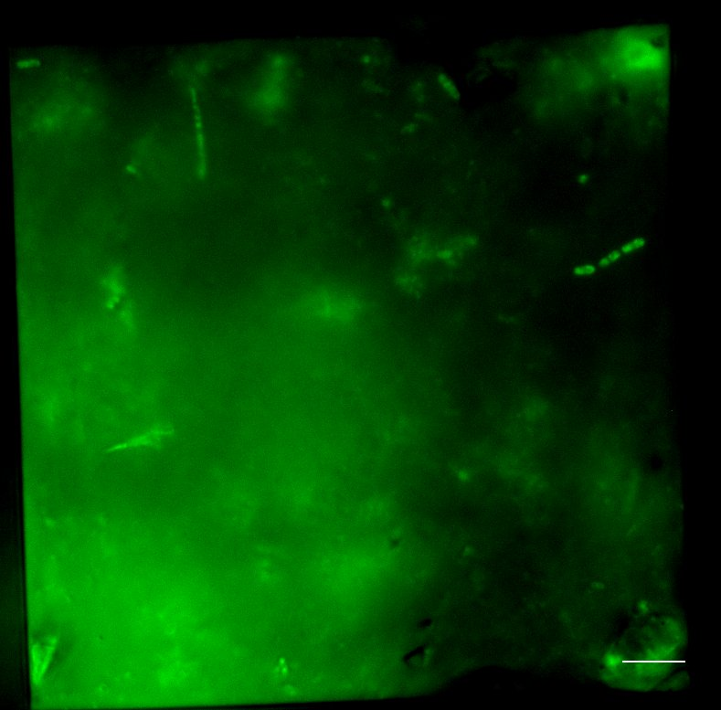
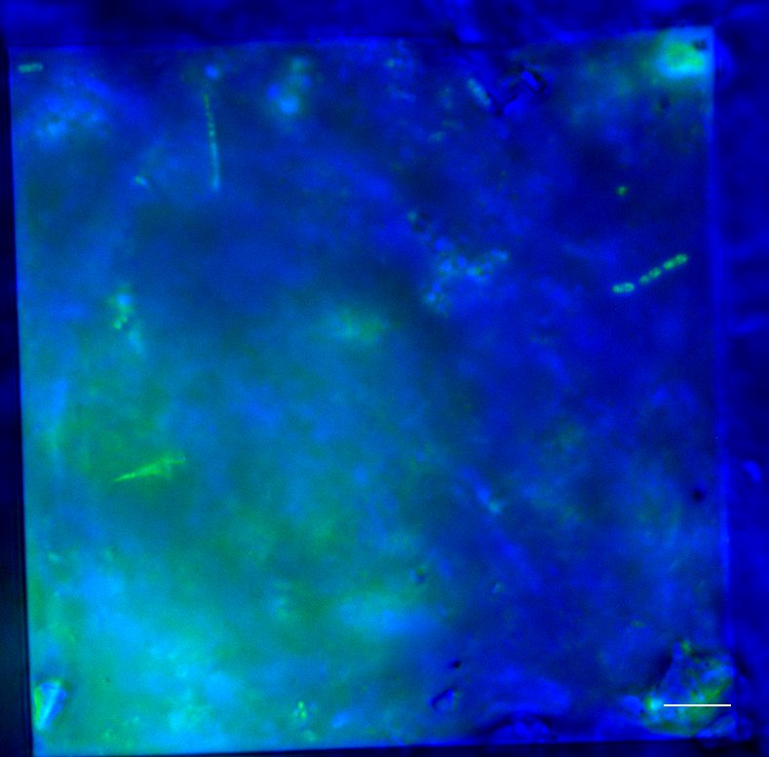
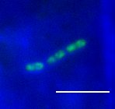
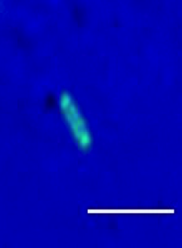
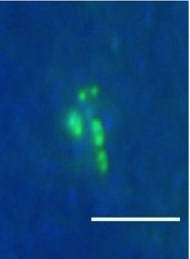
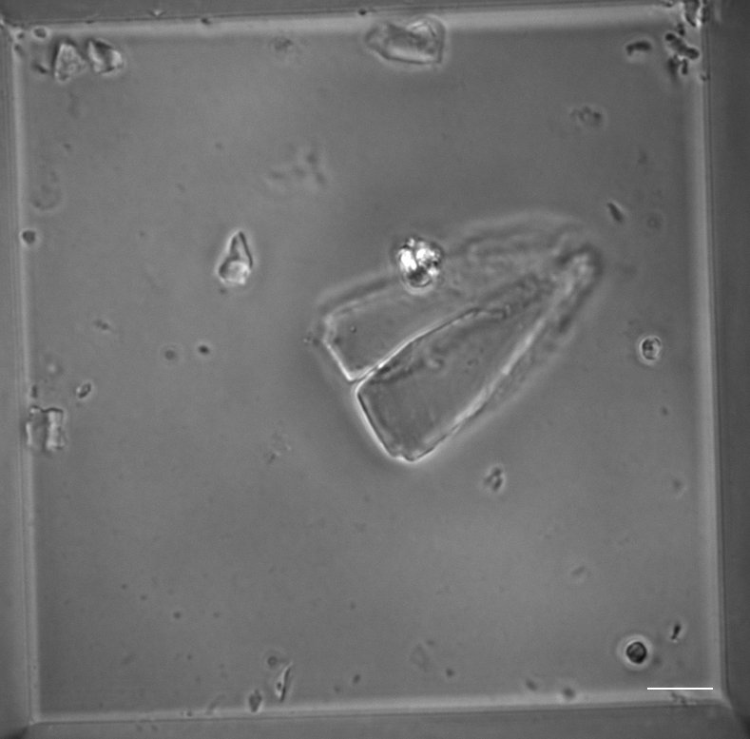
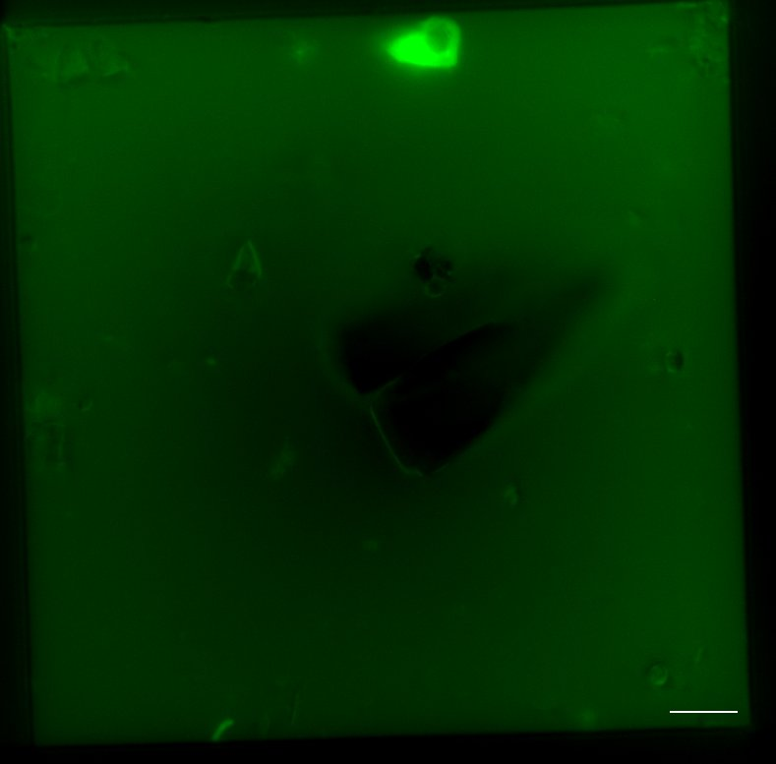
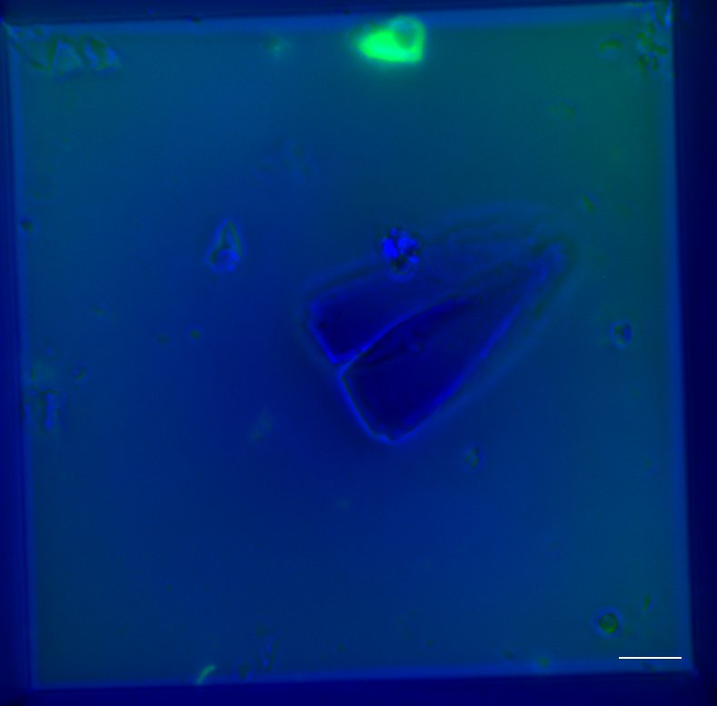

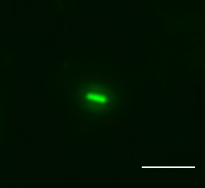
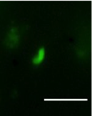
Visualisation of TB Patient Sputum & Bioaerosol
on Microwell Slide
Sputum
DMN-tre
Merge
Bio-Aerosol
DMN-tre
Merge
Sophia Gessner & Ryan Dinkele

Slide 11
Conclusions
Small bio-aerosol particles (1-5 μm diameter) are produced in the periphery of lungs
Collected small bio-aerosol particles represent non-invasive “BAL”
1950’s studies underestimated the high MTB in exhaled air because the collection efficiency of 1-5 micron diameter particles was exceptionally low
Individual transmissible MTB organisms can now be visualised in bio-aerosols
Diagnostic potential determined by volume of air sampled and sensitivity of detection methodology

Slide 12
Topics for Discussion
Recent insights on TB transmission biology
Ways to identify transmission hotspots
Potential for intervention and concrete applications
Is community infection control feasible?

Slide 13
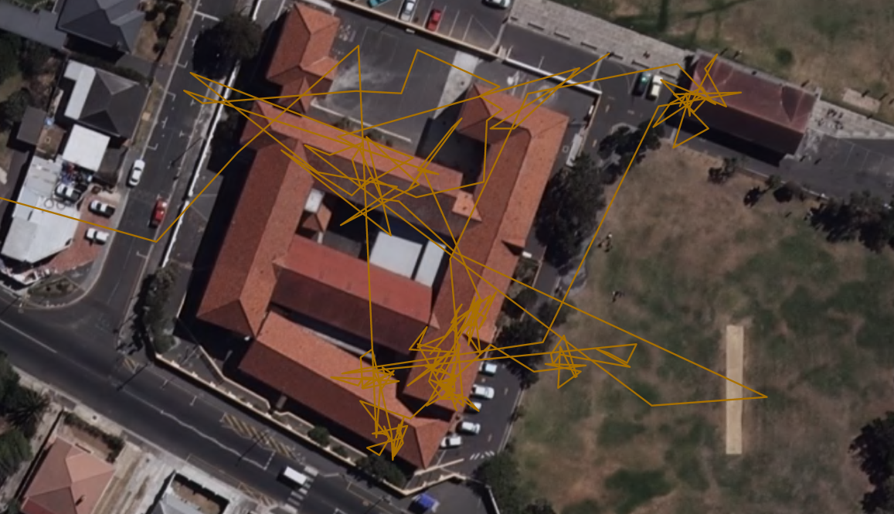
C₂
D
H
G
F
A
C₁
E
B
A
B
A
D
C₁
E
F
G
C₂
H
Richardson ET et al. Plos one 2014
Notes:
Focussing on schools. Here is can be seen how a child passes through their school day in a variety of rebreathed environments. Classrooms B and H get to near steady state while most of the others (note E and F) do not achieve steady state CO2 concentrations. Shows that standard modelling of the air in one room using steady state calculations is not appropriate for a situation such as this. This is where the power of rebreathed litres comes in because it is an integration of non steady state conditions and multiple locations containing different numbers of contacts.

Slide 14
Total House School Trans Other
Total House School Trans Other
Figure 4 A: Volumes of rebreathed air recorded in summer months. The figure shows median, inter-quartile ranges and maximum and minimum volumes of rebreathed air from others for 28 weekdays recorded between November and April together with volume contributions from households, school attendance, transport and various other locations.
Figure 4 B: Volumes of rebreathed air recorded in winter months. The figure shows volumes of rebreathed air from others for 63 weekdays recorded between May and October.

Slide 15
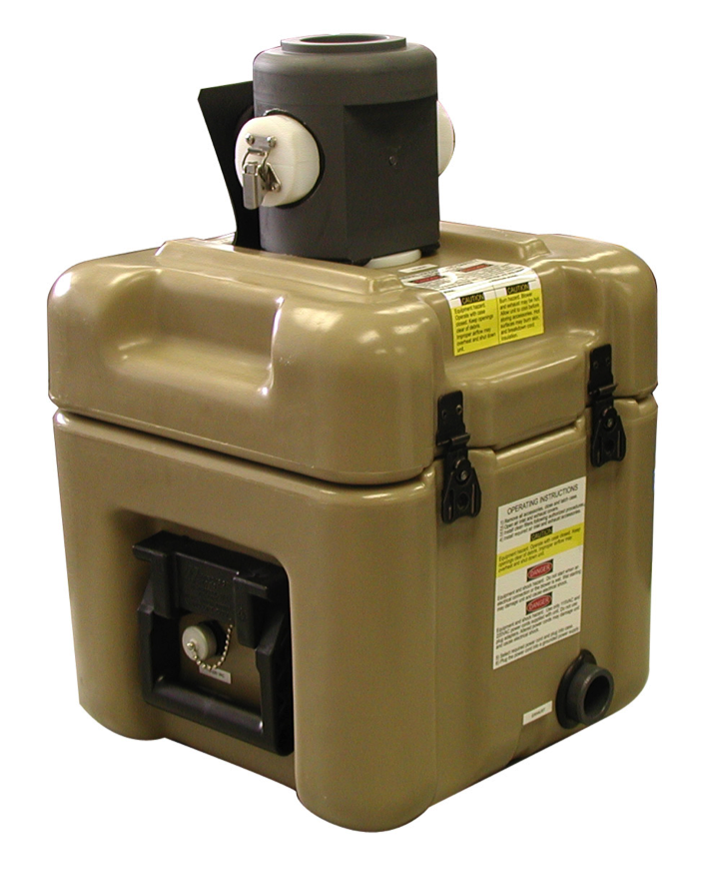
Monitoring of Congregate Settings
3900
High air volume filtration & ddPCR RD9 copy number
1250
Clinical cut-off
Primary School

Slide 16
Conclusions
CO₂ tracer gas levels are measure of per person ventilation and volume of air exchanged
CO₂ levels can be used to monitor single environment or potential exposure of individual trans locating through multiple environments defining the socio-environmental component of TB transmission
Volume of air exchanged between individuals can be estimated in multiple congregate settings
Large volume sampling congregate setting monitoring for MTB DNA may identify transmission settings
Environmental surface swabbing for MTB DNA may retrospectively identify transmission settings

Slide 17
Topics for Discussion
Recent insights on TB transmission biology
Ways to identify transmission hotspots
Potential for intervention and concrete applications
Is community infection control feasible?

Slide 18
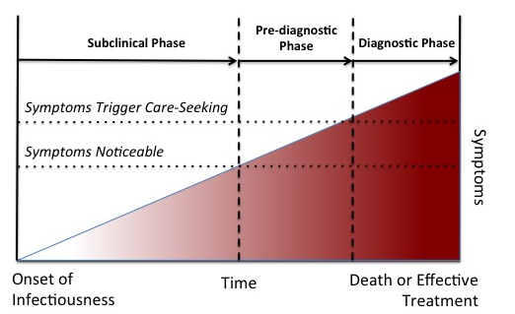
Model of Progression of TB Infection to TB Disease
Dowdy et al, AJRCCM, 2013
Dowdy et al, AJRCCM, 2013
Dowdy et al, AJRCCM, 2013
Dowdy et al, AJRCCM, 2013
Dowdy et al, AJRCCM, 2013

Slide 19
BAL adds 60%
Sputum & brochoscopic investigations
Laboratory confirmed TB
TB unconfirmed by diagnostic
Active case finding
Clinically defined TB
Spectrum of infectiousness defined by sensitive assay
Infectious pool includes clinical and non-clinically sick individuals
Potentially Infectious TB

Slide 20
Heterogeneity Model of TB Transmission
Socio-economic volume of air exchange | Community TB type | Transmission sources | Required control strategy
High >1000 L/day | Hyper-endemic | High, medium and low infectivity | Target reduction of air exchange CO₂ <1000 ppm
Medium 100-300L/day | Endemic | High and medium infectivity | Decrease prevalence by active non-sputum case finding
Low 10-50 L/day | Sporadic | Super spreaders | Rapid identification of point source case
Issarow et al, Royal Society Open Science; 2018; 5: 170726

Slide 21
Topics for Discussion
Recent insights on TB transmission biology
Ways to identify transmission hotspots
Potential for intervention and concrete applications
Is community infection control feasible?

Slide 22
^{Tuberculosis Epidemiology in} the Northern and Southern Hemispheres
MMR program
2.6 million CXR
13.4% pa
Hermans S, et al . PLoS ONE 2015;10(8): e0135179.
Notes:
Population 0.4 m in 1950. to 0.8m in 1982
Annual 13.4% of population 1950-80

Slide 23




Acknowledgements
Desmond Tutu HIV Centre
Carl Morrow
Melitta Gqada
Keren Middelkoop
Juane Leukes
Kedebone Oliver
UCT Microbiology
Digby Warner
Valerie Mizrahi
Sophia Gessner
Ryan Dinkele
Tim de Wet
Anastasia Koch
Stanford University
Carolyn Bertozzi
Mireille Kamariza
Jason Andrews
Zeteo inc
Wayne Bryden
Chuck Call
David Silcott

